Slide 1
Problem understanding

Slide 2
The business problem
A vehicle that can be powered by an electric motor that draws electricity from a battery and is capable of being charged from an external source and have an electric motor instead of an internal combustion engine
. The Electric Vehicle (EV) is not new, but it has been receiving significantly more attention in recent years. Advances in both EV analytics and battery technologies have led to increased automotive market share. However, this growth is not attributed to hardware alone. The modern mechatronic vehicle marries electrical storage and propulsion systems with electronic sensors, controls, and actuators, integrated closely with software, secure data transfer, and data analysis, to form a comprehensive transportation solution.
Advances in all these areas have contributed to the overall rise of EV’s, but the common thread that runs through all these elements is data analytics. The new EV’s are combined Electrical storage and propulsion systems with electronic sensors, controls, and actuators, integrated closely with software, secure data transfer to form a comprehensive transportation solution.

Slide 3
Business requirements
Key performance indicators:
Here we discuss about some of the key performance indicators of electric vechicles,
Brands according to body style
Top 10 effective EV brands
No of models by each brand
Different EV cars India
Top speed for different Brands

Slide 4
Brands according to body style
The easiest way to define a vehicle is by how it looks. What's the first thing you notice when a vehicle comes toward you on the street? Its shape. That's called the "body style.“
suv
SUVs—often also referred to as crossovers—tend to be taller and boxier than sedans, offer an elevated seating position, and have more ground clearance than a car. They include a station wagon-like cargo area that is accessed through a flip-up rear hatch door, and many offer all-wheel drive.

Slide 5
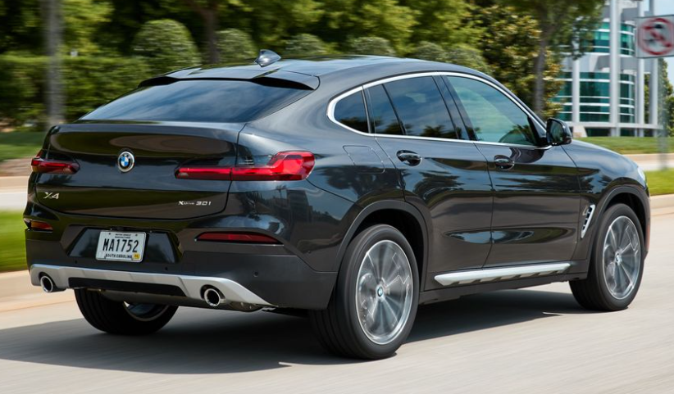
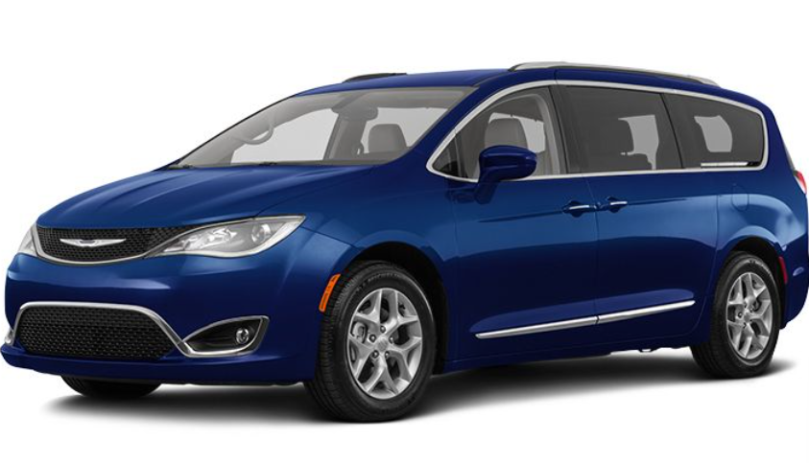
There's more to it than basic body types. Those 10 types of vehicles are available from dozens of different brands from Acura to Volvo—and in many sizes and at widely varying prices. But there are always a few outliers that don't quite fit neatly into any category, like the BMW X4 "four-door coupe SUV“
Minivans are the workhorses of the family-car world, the best at carrying people and cargo in an efficient package. They're called minivans but they are far from "mini." That's because they are tall boxes-on-wheels with sliding side doors for easy access and a rear hatch that opens to a large cargo area. Most minivans have adjustable seats in their second and third rows that often can be removed or even folded into the floor to create a huge open cargo bay. The Honda Odyssey and Chrysler Pacifica are great examples of the breed.

Slide 6

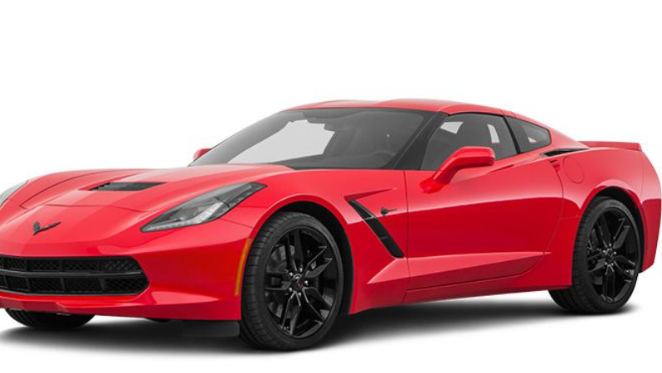
A pickup truck has a passenger cab and an open cargo bed in the rear. Virtually all pickups offer some form of all-wheel drive or part-time four-wheel drive—the latter for off-road use only. With one exception—the mid-sized Honda Ridgeline—pickup bodies are cabs mounted to a separate steel frame. The Ridgeline is more like a crossover with the rear section of the roof lopped off to expose a cargo bed. Currently, pickup trucks come in two size categories: full-size and mid-size.
These are the sportiest, hottest, coolest-looking coupes and convertibles—low to the ground, sleek, and often expensive. They generally are two-seaters, but sometimes have small rear seats as well. Cars like the Porsche 911 and Mazda Miata are typical sports cars, but you can stretch the definition to include muscle cars like the Ford Mustang and Dodge Challenger.

Slide 7
10 most efficient EV brands
Most Efficient Electric Vehicles (Energy Use Per 100 Miles)
1. 2022 Tesla Model 3 RWD: 25 kWh
2. 2022 Lucid Air Grand Touring w/19-inch wheels: 26 kWh
3. 2022 Chevrolet Bolt EV: 28 kWh
4. 2022 Hyundai Kona EV: 28 kWh
5. 2022 Tesla Model S: 28 kWh
6. 2022 Tesla Model Y Long Range: 28 kWh
7. 2022 Chevrolet Bolt EUV: 29 kWh
8. 2022 Kia EV6 RWD: 29 kWh
9. 2022 Hyundai Ioniq 5 RWD: 30 kWh
10. 2022 Kia Niro EV: 30 kWh

Slide 8
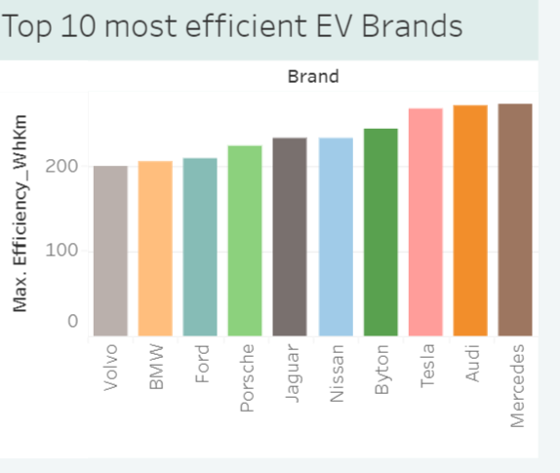
Mercedes are the most efficient EV brands
Nonetheless, the automotive industry is evolving. Companies are rushing to develop new modes of mobility, including self-driving cars, as governments and a select few consumer’s push for electric vehicles. The conventional advantages of Mercedes-Benz are put to the test by some of these new technologies, such as electric propulsion systems. The three-pointed star was after all renowned for its advanced engine technology

Slide 9
No of models by each brand
Here the top 10 brand are compared by how may models they present to the world, the observation are noted and examined. The models which are famous are given

Slide 10
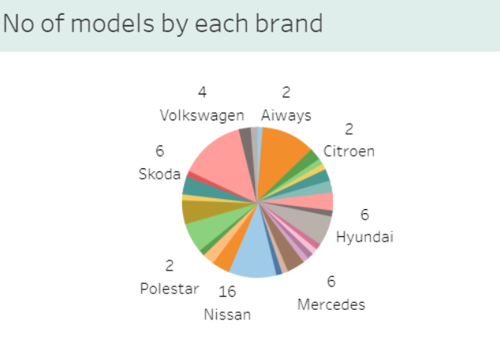
Tesla is the car company has the most electric car models
tesla (TSLA) is the undisputed leader among the biggest electric car companies by market capitalisation.
The EV giant produced over 439,000 and delivered over 405,000 vehicles in the fourth quarter of 2022. In 2022, its deliveries were 1.31 million while production increased to 1.37 million, according to the firm’s lates

Slide 11
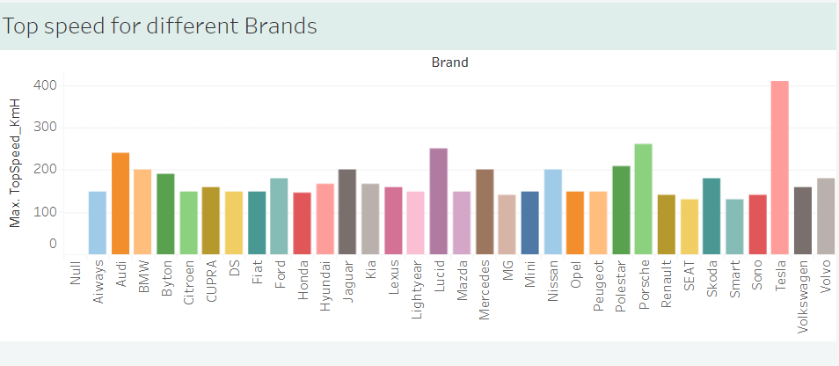
Top speed for different brands

Slide 12
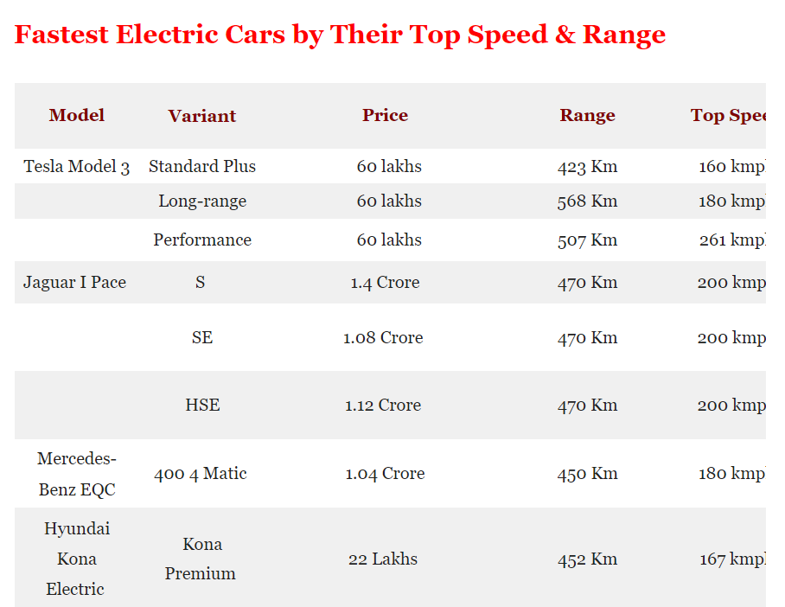
Tesla produces high speed range cars which can range from 568km ,
Although Tesla is primarily known for making electric cars mainstream, it doesn't stop there. It has other innovations linked to vehicle and battery technologies. For example, Tesla is hard at work improving its self-driving technology, hoping to be the first car company to introduce full self-driving capabilities.

Slide 13
Areas of improvement in EV vechicls
The only question that remains is not if but when EVs will finally take over the car industry. According to our survey, virtually all influencers interviewed predict EVs to dominate by 2030-2040.
Improved battery tech will make EVs more affordable and attractive than gas cars, thus boosting demand. Production tech will make EVs available for the masses by ensuring supply can keep up with rising demand. Bidirectional charging will make our grid ready for more EVs and support clean energy transition.

Slide 14
Reaching more efficient mass production will also help in reducing prices through leveraging economies of scale. As Bokor points out: “Improve on hastening the scale-up of OEMs to increase EV production in order to support much more mass adoption by lowering pricing to achieve cost parity against ICEVs.”
Finally, making EVs more attractive to the masses will also require a wider range of electric car models to become available. This will allow different types of customers to find a car that suits their specific needs. Tesla already seems to have great success with this strategy with reports showing reservations for its newly introduced Cybertruck already totaling 650.000 since the end of November. This is also why Chris from Car Maniac states that besides “significantly improved charging times and range”, he mostly hopes to see “a bigger availability of EV models” hit the market within the next ten years.

Slide 15
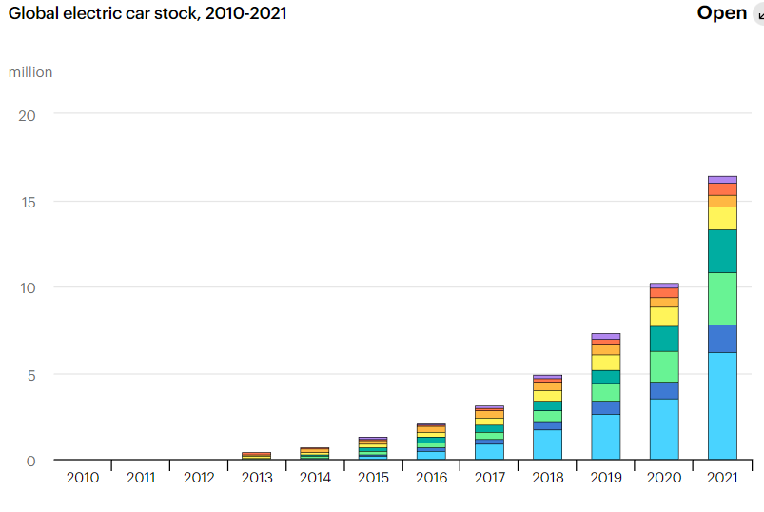
LATEST TRENDS IN ELECTRIC VEHICALS
Over 16.5 million electric cars were on the road in 2021, a tripling in just three years Sales of electric cars reached another record high in 2021 despite the Covid-19 pandemic and supply chain challenges, including semiconductor chip shortages. Looking back, about 120 000 electric cars were sold worldwide in 2012. In 2021, that many were sold in a week.
After increasing in 2020 despite a depressed car market, sales of electric cars – battery electric vehicles (BEVs) and plug-in hybrid electric vehicles (PHEVs) – nearly doubled year-on-year to 6.6 million in 2021.1 This brought the total number of electric cars on roads to over 16.5 million. As in previous years, BEVs accounted for most of the increase (about 70%).
EV markets are expanding quickly. Electric car sales accounted for 9% of the global car market in 2021 – four-times their market share in 2019. All the net growth in global car sales in 2021 came from electric cars. Sales were highest in the People’s Republic of China ("China" hereafter), where they tripled relative to 2020 to 3.3 million after several years of relative stagnation, and in Europe, where they increased by two-thirds year-on-year to 2.3 million. Together, China and Europe accounted for more than 85% of global electric car sales in 2021, followed by the United States (10%), where they more than doubled from 2020 to reach 630 000.

Slide 16
Insights
Customers are willing to buy EV cars which are more efficient and gives high performance .
EV cars in india are not the most famous one in global level but they are making a very significant change in the industry .
To improve the performance of the vechicle body style , efficiency , speed plays a major role in it.

Slide 17
Electric Vehicle Performance
We use an objective, data-driven approach to analyze four key aspects related to vehicle performance to give you the best electric vehicle recommendations based on your needs.
Some just look at the fastest electric cars to judge performance. Still, we consider horsepower, top speed, acceleration, and drive type when analyzing performance to give you a better recommendation for which electric cars will perform in the most real-world situations.

Slide 18
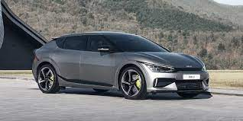
Horsepower
The electric cars with the most horsepower generally have the most powerful batteries. Horsepower determines how much power your electric vehicle can muster.

Slide 19
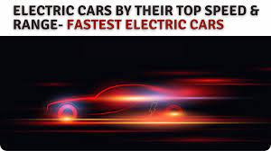
Top Speed & Acceleration
Top speed is the maximum speed your electric car can travel. If you are looking for the fastest electric car, performance is important to you.
Some of the fastest electric cars can top speeds of over 250 mph, but you’ll pay a higher premium for some of these. Still, many electric cars have no problem reaching speeds well over 100 mph.
As of today, electric (depending on the manufacturers) can have a slightly slower top speed than gas-powered vehicles.
Electric vehicles have lower top speeds because the manufacturers limit top speeds to preserve battery consumption.
Therefore, we use top speed as a dimension of performance based on your criteria.
Acceleration measures how quickly the electric vehicle can go from a standstill to 60 seconds in seconds. Since electric cars have instant torque where the motor directly powers the wheels, acceleration times are quicker than gas-powered cars. We use acceleration to measure quickness, which acts as a factor to determine what electric car has the best performance to match your criteria. The electric cars with the fastest acceleration will help with performance ratings.

Slide 20
Front-wheel drive is where the front two tires receive power from the motor. The benefit of having a front-wheel drive is traction in the rain and snow versus a rear-wheel-drive vehicle. The downside of a front-wheel-drive car is handling. Front-wheel drive handles the worst out of the three drive types.
Rear Wheel Drive
Rear-wheel drive is where the back tires of the vehicle receive power from the motor.
As a result, rear-wheel-drive enjoys better than average handling.
On the downside, rear-wheel drive electric vehicles are at their weakest in rain and snow
Front-Wheel Drive
All Wheel Drive
As a result, all-wheel-drive electric vehicles enjoy excellent traction and are the best option for handling rain and snow. All-wheel drive cars also enjoy better than average handling making it a good choice for weather and handling. The downside of all-wheel drive is cost and weight. All-wheel-drive systems mean adding cost and weight to your electric vehicle making the feature available in more mid to higher-end electric cars.

Slide 21
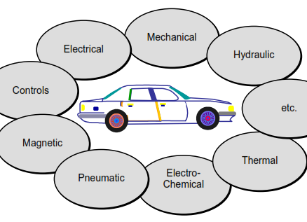
EV motor efficiency
Let's start with electric vehicle motor efficiency.
An EV directly converts electricity into movement. This makes it far more efficient than a conventional car, which has to burn fuel (creating heat) and then convert that heat into motion.
Did you know that an EV can be more than 70% efficient from the moment you turn it on? Even the best diesel engine, fully warmed up, struggles to get to 40% efficiency. In other words, a conventional car wastes well over half the energy in its fuel.

Slide 22
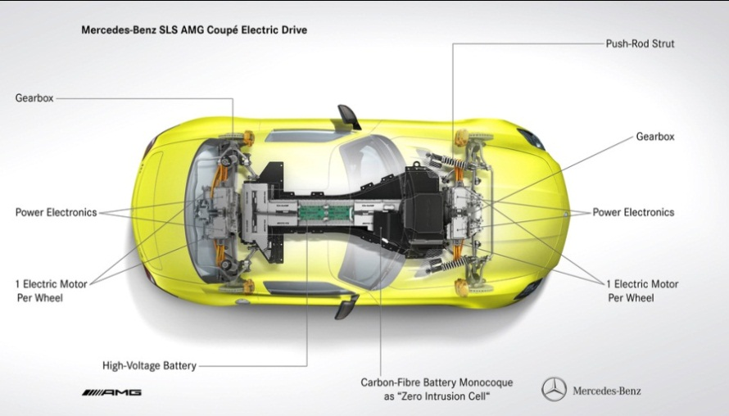
Charging up versus filling up will be better for your wallet in the long-run.
In fact, you'll save over the years with an EV.
Keen to more about the exact costs and savings of owning and running an EV? Read more about electric car costs here.
If you want to be even more environmentally-friendly then charge up by generating your own renewable, zero-emission electricity!
This way you'll be really minimising the environmental impact of using a car.
Discover more about the ways you can generate energy at home.
Efficient charging

Slide 23
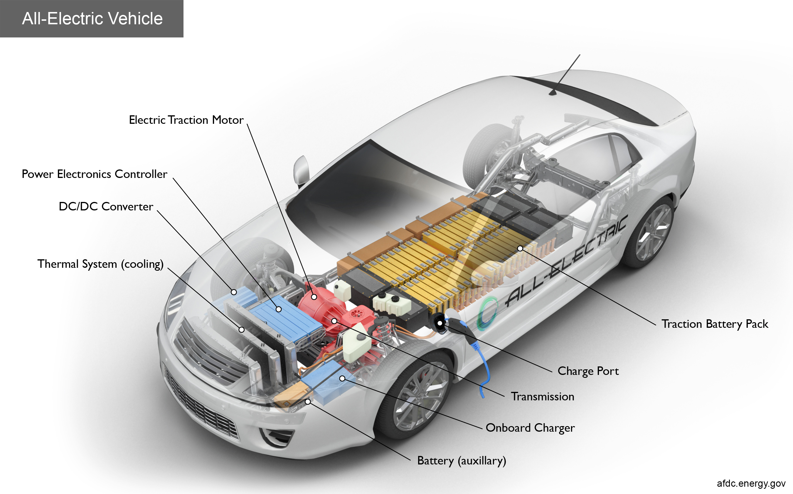
Electric cars are the future: the new generation of travel. And as the UK leader in low-carbon energy, we’re here to get you on the road and ahead of the curve. To qualify, simply lease an electric car through us and sign up for an EDF electricity tariff.

Slide 24
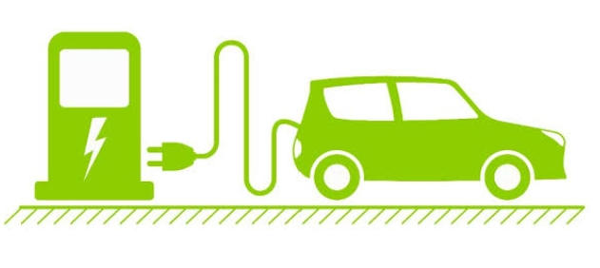
SOCIAL IMPACT

Slide 25
SOCIAL IMPACT OF ELECTRIC CAR SALES.
Electric car sales have increased steadily – what is the social impact? The number of electric cars in use has increased steadily in the last decade. This is due to better technologies, government incentives, more and better manufacturing capacity, greater electric vehicle infrastructure, and a consumer population willing to switch to vehicles that have a lower carbon profile. In the US, the new “Inflation Reduction Act” directs $369 billion of government incentives to manufacturing and resource extraction for support of electric vehicles. But what is the social impact of electric cars? How do they benefit society as a whole? There’s a lot more to electric cars than meets the eye. In this blog post, we will discuss the social impact of electric cars and how they are changing the world for the better.

Slide 26
INTRODUCTION OF SOCIAL IMPACT.
Electric cars have been around for over a century, but they only recently started to become popular. The first electric car was built in 1891, and the technology has come a long way since then. Today’s electric cars are much more efficient and reliable than their early ancestors. And thanks to advances in battery technology, they can now travel for hundreds of miles on a single charge. One of the main reasons why people are interested in electric cars is because they’re environmentally friendly. The zero-emissions performance of electric cars is great for reducing an individual’s carbon footprint. Travel, including personal travel and commuting to work, is a major contributor to carbon emissions. And because Evs are so efficient, they use less energy than traditional gasoline cars. The combination of higher efficiency in terms of miles per kWh of energy used and the nature of the electric grid containing renewable sources powering it means electric cars reduce your carbon footprint in multiple, synergistic ways.

Slide 27
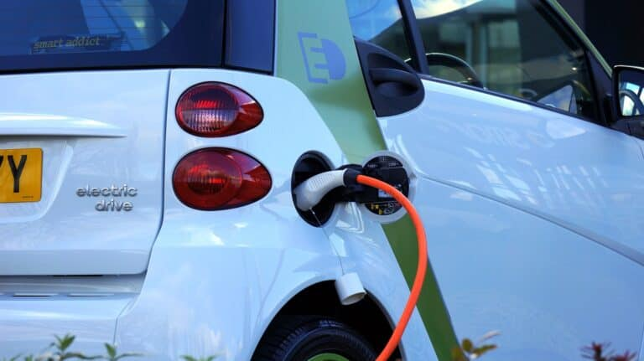
Another reason is electricity is cheaper than gas on a per mile basis for both United States and Europe. This obviously only holds true as long as gasoline prices stay at their prices and not drop too far. Given the geopolitical events of 2022, and the energy crisis engendered by the Russia-Ukraine war, in the short term electrical vehicles seem like a smart move. In short, you’ll save money on fuel costs with an electric car. And because electric cars lack the complex set of moving parts of an internal combustion engine, they require less maintenance than gasoline cars. As a result, you’ll save money on maintenance and repairs with an electric car.

Slide 28
PROS AND CONS OF ELECTRIC VEHICLES
Pros of electric cars
Electric cars are energy efficient
Electric cars reduce emissions
Electric cars require lower maintenance
CONS OF ELECTRIC CARS
Electric cars can't travel as far
“Fueling” takes longer
Electric cars are sometimes more expensive

Slide 29
BENEFITS OF ELECTRIC VEHICLES
Transport is a fundamental requirement of modern life, but the traditional combustion engine is quickly becoming outdated. Petrol or diesel vehicles are highly polluting and are being quickly replaced by fully electric vehicles. Fully electric vehicles (EV) have zero tailpipe emissions and are much better for the environment.

Slide 30
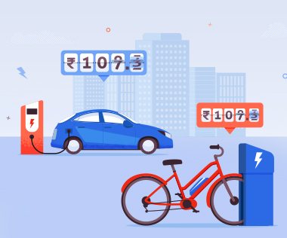
Lower running costs
Electric vehicles use electricity to charge their batteries instead of using fossil fuels like petrol or diesel. Electric vehicles are more efficient, and that combined with the electricity cost means that charging an electric vehicle is cheaper than filling petrol or diesel for your travel requirements.

Slide 31
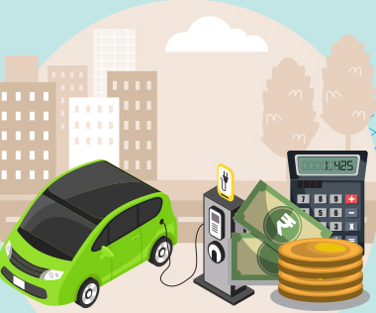
Low maintenance cost
Electric vehicles have very low maintenance costs because they don’t have as many moving parts as an internal combustion vehicle. The servicing requirements for electric vehicles are lesser than the conventional petrol or diesel vehicles. Therefore, the yearly cost of running an electric vehicle is significantly low.

Slide 32

Zero Tailpipe Emissions
Driving an electric vehicle can help you reduce your carbon footprint because there will be zero tailpipe emissions. You can reduce the environmental impact of charging your vehicle further by choosing renewable energy options for home electricity.

Slide 33
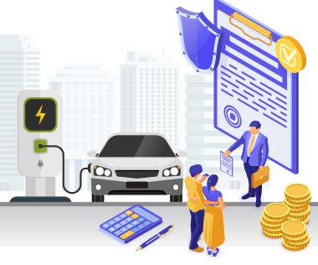
Tax and financial benefits
Registration fees and road tax on purchasing electric vehicles are lesser than petrol or diesel vehicles. There are multiple policies and incentives offered by the government depending on which state you are in.

Slide 34

Petrol and diesel use is destroying our planet
The availability of fossil fuels is limited, and their use is destroying our planet. Toxic emissions from petrol and diesel vehicles lead to long-term, adverse effects on public health. The emissions impact of electric vehicles is much lower than petrol or diesel vehicles. From an efficiency perspective, electric vehicles can covert around 60% of the electrical energy from the grid to power the wheels, but petrol or diesel cars can only convert 17%-21% of the energy stored in the fuel to the wheels.

Slide 35

Electric Vehicles are easy to drive and quiet
Electric vehicles don’t have gears and are very convenient to drive. There are no complicated controls, just accelerate, brake, and steer. When you want to charge your vehicle, just plug it in to a home or public charger. Electric vehicles are also quiet, so they reduce noise pollution that traditional vehicles contribute to.

Slide 36
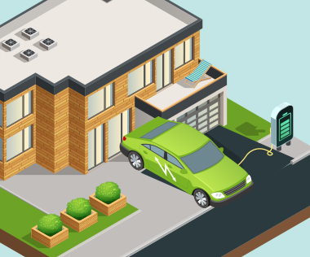
Convenience of charging at home
Imagine being at a busy fuel station during peak hours, and you are getting late to reach your workplace. These problems can easily be overcome with an electric vehicle. Simply plug your vehicle in at your home charger for 4-5 hours before you plan to go. If you are able to get a charger where you park at home, it is very convenient to plan your journeys in advance. What if you forget to plug in your machine someday? Then you can easily take the help of fast chargers or even battery swapping services if you are on a two-wheeler on the road.

Slide 37

No noise pollution
Electric vehicles have the silent functioning capability as there is no engine under the hood. No engine means no noise. The electric motor functions so silently that you need to peek into your instrument panel to check if it is ON. Electric vehicles are so silent that manufacturers have to add false sounds in order to make them safe for pedestrians.

Slide 38
CONCLUSION
When it comes to climate change and air quality, electric cars are clearly preferable to petrol or diesel cars. Contrary to some public doubts and uncertainties about the environmental benefits of electric cars, the science is increasingly clear

Slide 39
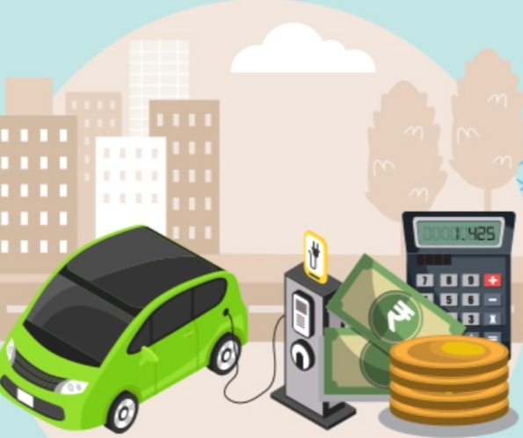
BUSINESS MODEL OR IMPACT

Slide 40
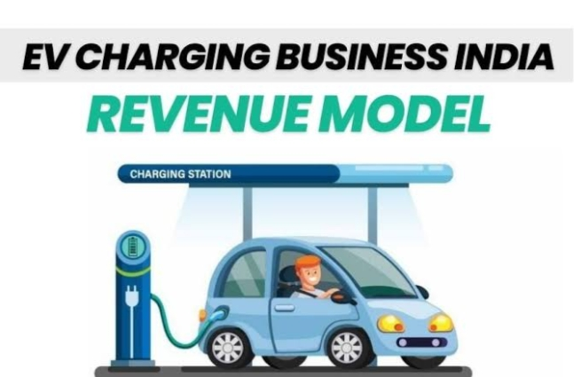
INTRODUCTION
There are a range of business models that can be applied to electric vehicle charging points, each suited to a different business objective.
They include:
Loss leader model; offer free charging to attract drivers.
Cost recovery; set a usage fee to cover the cost of your chargepoints.
Profit making; set a usage fee that covers your costs and generates profit.
Fully funded; a network operator funds the installation of your chargepoints, with conditions on their operation.

Slide 41
EV CHARGING BUSINESS MODEL.
When considering an EV charging business model, it’s important to understand which models will be most effective for the type of visiting driver and the type of location/business where the charging stations will be installed, as well as the typical costs incurred.
Whatever approach you are looking to take, flexibility and scalability are absolutely critical for such a young and fast paced industry.
It’s key to work with a charging provider who will take the time to understand your location and make a tailored recommendation on what chargepoints and business model will be most effective.

Slide 42
What business/monetisation models are available for commercial EV charging?
For many businesses that rely on customers arriving by car, the revenue earned from EV driving customers using their business dwarfs the costs of electricity. It can therefore be sensible to absorb these costs rather than levy a fee that may deter drivers from visiting.

Slide 43
Operational cost or total cost recovery
In general, the more competitive the price levied, the more drivers you will attract with EV charging stations. But it is also worth considering the need state of your driver. For example, a driver on a short journey will be less willing to pay to charge than one who has done more mileage and will have a long onwards journey.
If a tariff is set, it’s imperative to make the billing method easy to understand, access and use (e.g. apps and contactless payment cards for rapid chargers).

Slide 44
Profit making
Profit making models have broadly the same constraints as the cost recovery models, albeit with preferential financials for those locations where there is no alternative for drivers to charge. However, the disincentive for drivers to opportunity charge gets more acute as the price increases.
There can also be concern over reputational damage if your business is seen to be unfairly exploiting drivers by setting too high a tariff.

Slide 45
Fully funded
In some circumstances, charging infrastructure providers will offer to provide and install chargepoints free of charge to a business. This can work very effectively, but it is important to take a long term view to ensure that what is offered is of mutual benefit to you and your customers.

Slide 46
What are the costs associated with commercial EV charging?
When planning the installation of charging infrastructure, it is first important to understand the likely costs.

Slide 47
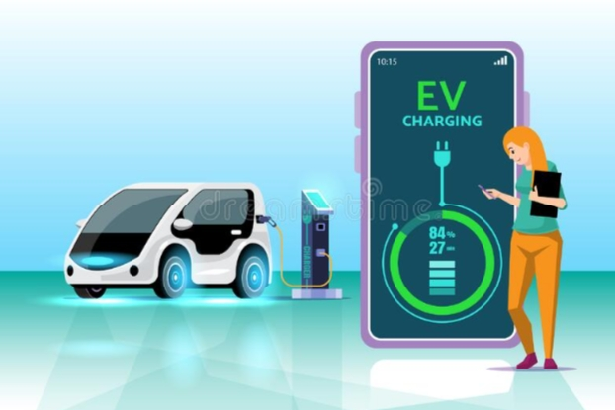
Chargepoint hardware costs
Hardware costs vary depending on the power that chargepoints can deliver, the features that they offer and their build quality.

Slide 48
Average costs
Charger power rating | kWh added per 30 minutes charging | Approx miles of range added per 30 minutes charging for a hypothetical 80kWh BEV | Electrical cost (assuming business paying 12p per kWh)
7kW top-up charging | 3.5kWh | 12.5 | £0.42
50kW rapid charging | 25kWh | 87.5 | £3.00
150kW en route charging | 75kWh | 262.5 | £9.00

Slide 49
Electricity used for Charging vehicles
In addition to the electricity used for charging vehicles, EV chargepoints have a standby draw (powering LEDs etc). The standby draw will be much lower than power delivered for charging, but it is worth ensuring the standby draw is sensibly low (For example, the standby draw of the Pod Point Solo 3 is ~0.003kW and the Pod Point Twin ~0.006kW).

Slide 50
Ongoing maintenance costs
To ensure the charging infrastructure remains operable, some maintenance will likely be required. Most reputable providers will offer some combination of maintenance and/or extended warranties.

Slide 51
Conclusion
The goal of this article is twofold: first, to review the business model literature on electric mobility with focus on electric vehicles while using the five elements of the business model as a framework and second, to distill key insights from the literature.

